Slide 1

Tele-Marketing Sales Prediction
Predict Product Sale
by
Classification Model
Case Study: Oasis

Slide 2
Objective
Descriptive Analysis
Data Analysis
Visualization
Data Pre-Processing
Feature Creation and Preparation
Outlier Treatment
Imputation Method
Model Preparation
Sampling Techniques
Over sampling
SMOTE
SMOTE Tomek
Modelling Algorithms
Random Forest
XGBOOST
Results

Slide 3
Descriptive Analysis - Data Analysis
Sale | 0 | 1
Product_ID
142 | 93.156987 | 6.843013
143 | 94.085318 | 5.914682
144 | 92.163319 | 7.836681
145 | 89.097009 | 10.902991
146 | 92.508165 | 7.491835
147 | 92.967568 | 7.032432
148 | 89.271320 | 10.728680
149 | 90.556854 | 9.443146
150 | 90.454500 | 9.545500
151 | 92.996305 | 7.003695
Sale | 0 | 1
Gender
Female | 91.769162 | 8.230838
Male | 90.911189 | 9.088811
Others | 87.090164 | 12.909836
Sale | 0 | 1
Timezone
0 | 48.148148 | 51.851852
2 | 91.288860 | 8.711140

Slide 4
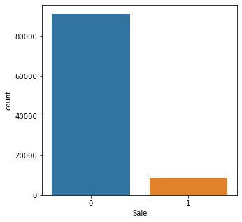
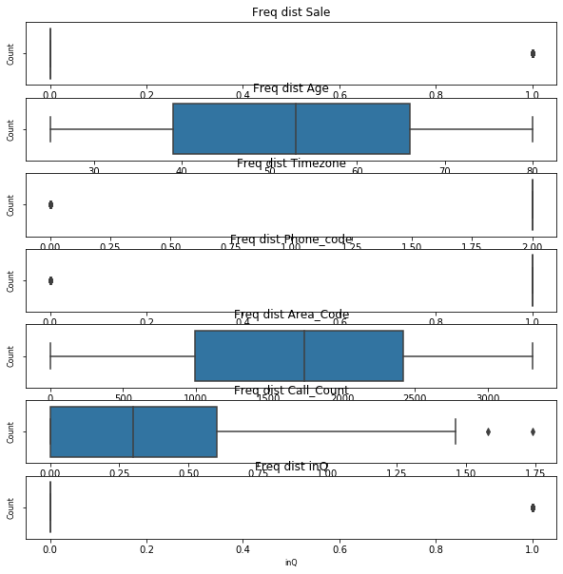
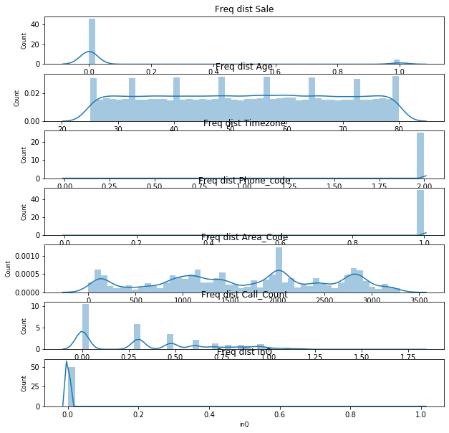
Descriptive Analysis - Data Visualization

Slide 5
Data Pre-Processing
Feature Creation
Variable: “inQ”
Created from Agent_ID
Indicated as Binary Value
Feature Preparation
Variables
“Sale”
“ Phone_Code”
Converted to : “Binary Values 0,1”
Label Encoding on “Area_Code”
One – Hot coding
“Agent_ID”
“Product_ID”
“Gender”
Outlier Treatment
Variable
“Call_count”
Log Transformation (Log10)
Imputation Method
Variables
“Agent_ID”, “Area_Code”
Methods:
“1111- as Unknown”, ” Median”

Slide 6
Model Prep - Sampling Techniques
Oversampling
One common way to tackle the issue of imbalanced data is over-sampling. Over-sampling refers to various methods that aim to increase the number of instances from the under-represented class in the data set.
SMOTE (Synthetic Minority Oversampling TEchnique):
A data generator algorithm that adjusts the distribution of the classes in a dataset by creating data that resembles the original one. It aims to balance class distribution by randomly increasing minority class examples by replicating them.
SMOTE Tomek: (Combined Over sampling and Under sampling)

Slide 7
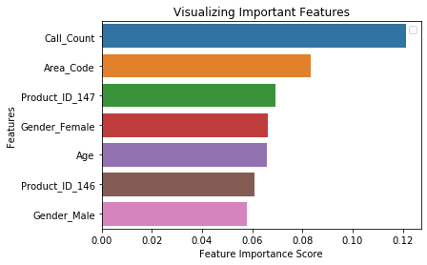
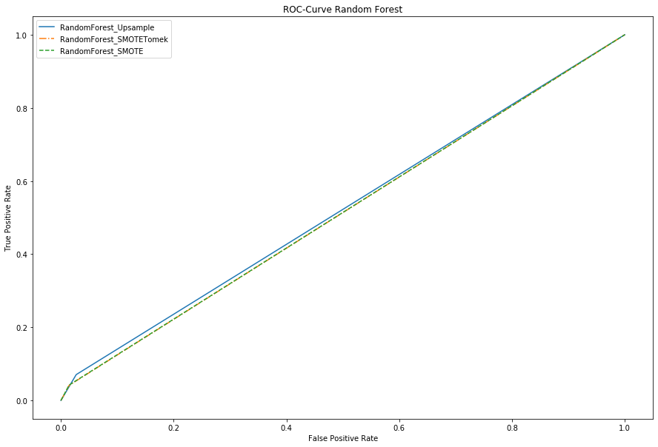
Model Prep - Modelling Algorithm (RandomForest)

Slide 8
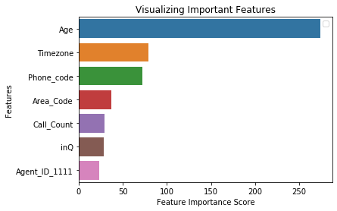
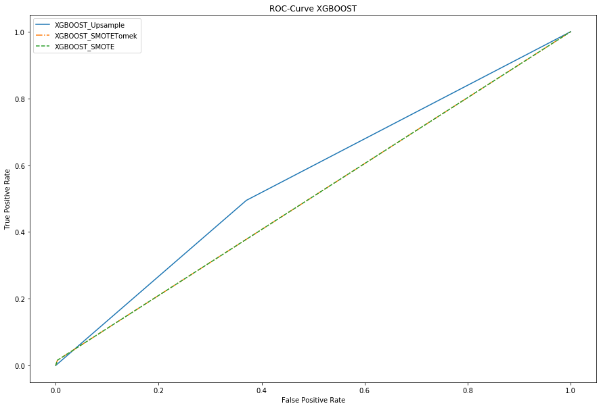
Model Prep - Modelling Algorithm (XGBOOST)

Slide 9
Results
Model_ID | Model | Sampling Method | Accuracy | F1 Score | Recall | ROC-AUC | PR-AUC
0 | RF | Upsample | 0.892 | 0.105 | 0.071 | 0.522 | 0.180
1 | RF | SMOTE | 0.901 | 0.071 | 0.040 | 0.514 | 0.175
2 | RF | SMOTETomtek | 0.901 | 0.069 | 0.041 | 0.513 | 0.174
3 | XGB | Upsample | 0.618 | 0.189 | 0.495 | 0.562 | 0.328
4 | XGB | SMOTE | 0.909 | 0.030 | 0.016 | 0.506 | 0.213
5 | XGB | SMOTETomtek | 0.909 | 0.030 | 0.016 | 0.506 | 0.213

